Slide 1
Final Project: Predicting Mortgage Deliquency
Luke Bogacz, Vishal Sinha, Jason Long • 04.29.2019
DATS6203, Machine Learning II, Dr. A. Jafari

Slide 2
Mortgage Loan
Data set source:
Fannie Mae
Databases
Loan orgination piece, size
Loan status piece, size
What we worked with:
18 years of loan data
Subset to 1 year (2017)
877,803 records used

Slide 3
Pytorch
Framework
Pytorch library
Custom class
ModelBuilder, custom engine
LoanPerformanceDataset, custom dataloader
MLP
Mulit-layer Perceptron Network

Slide 4
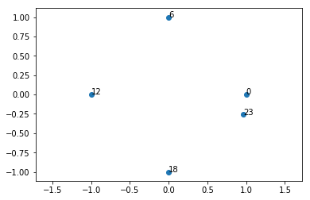
Pre-Processing
Overview
Processed in ~10,000 row chunks
Stored in Postgres SQL Database
Split into train/test/validate views
Normalization
Sin/Cos for cyclical features(months)
StandardScalar [numerical]
OneHotEncoder [categorical]
Notes:
CREATE VIEW test AS
SELECT *
FROM acquisition
WHERE ABS(MOD(loan_id, 1.1)) = 1; -- < random using modulo

Slide 5
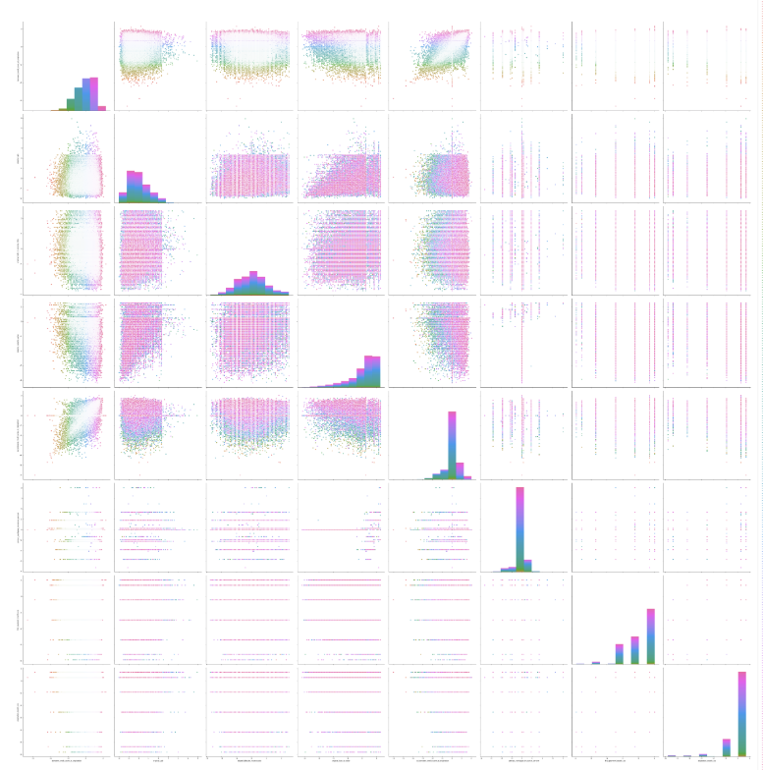
Feature Selection
Using Ensembles
DecisionTreeClassifier & RandomForestClassifier
Subset of data used (50,000 records)
1026 Features (after encoding)
Importances > 1 * std dev

Slide 6
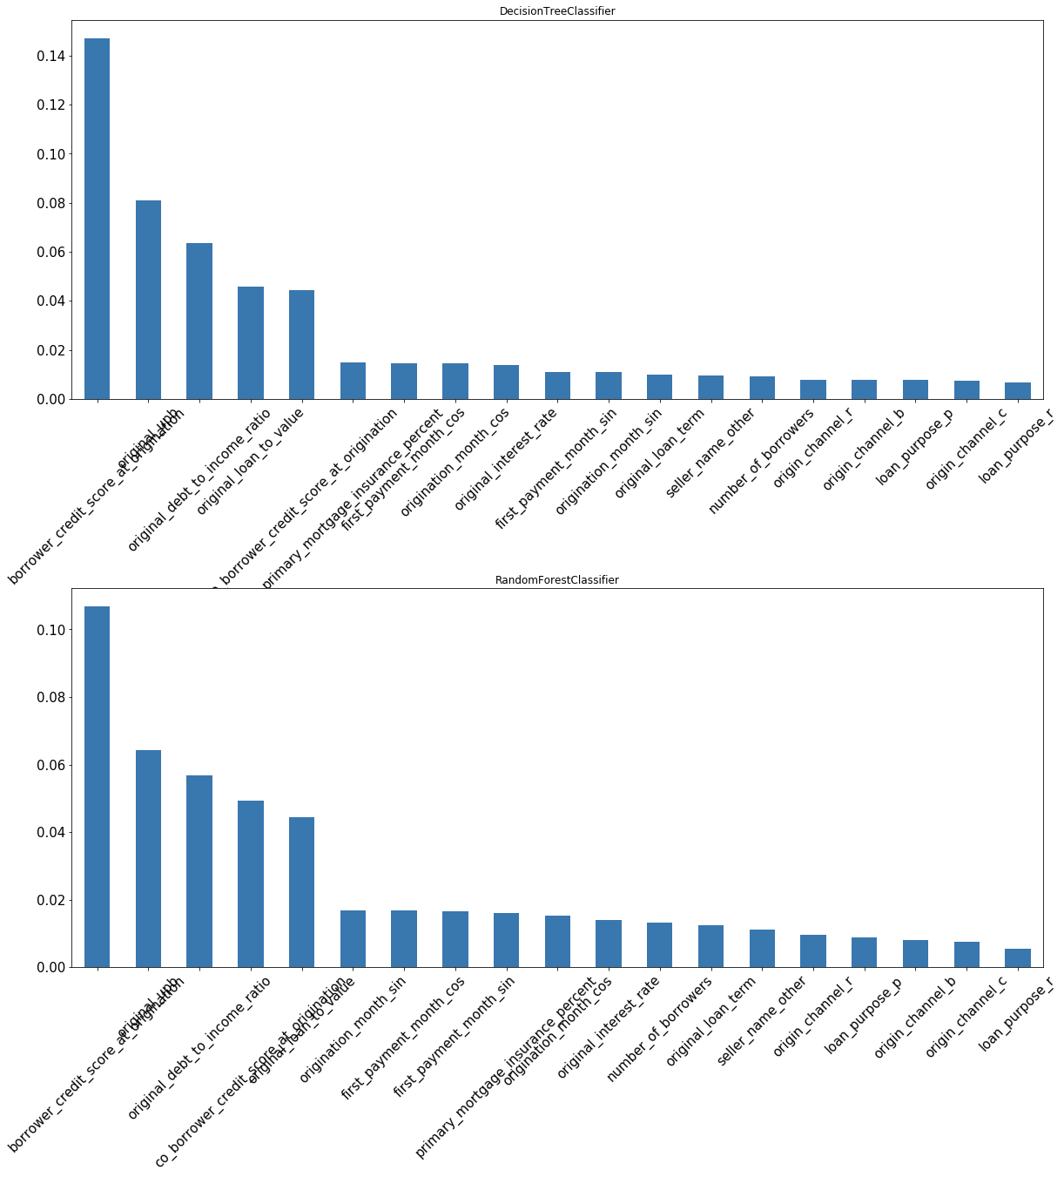
Feature Selection
Top Features
'borrower_credit_score_at_origination',
'original_upb',
'original_debt_to_income_ratio',
'original_loan_to_value',
‘co_borrower_credit_score_at_origination',
'primary_mortgage_insurance_percent',
'first_payment_month_cos',
'origination_month_cos'

Slide 7
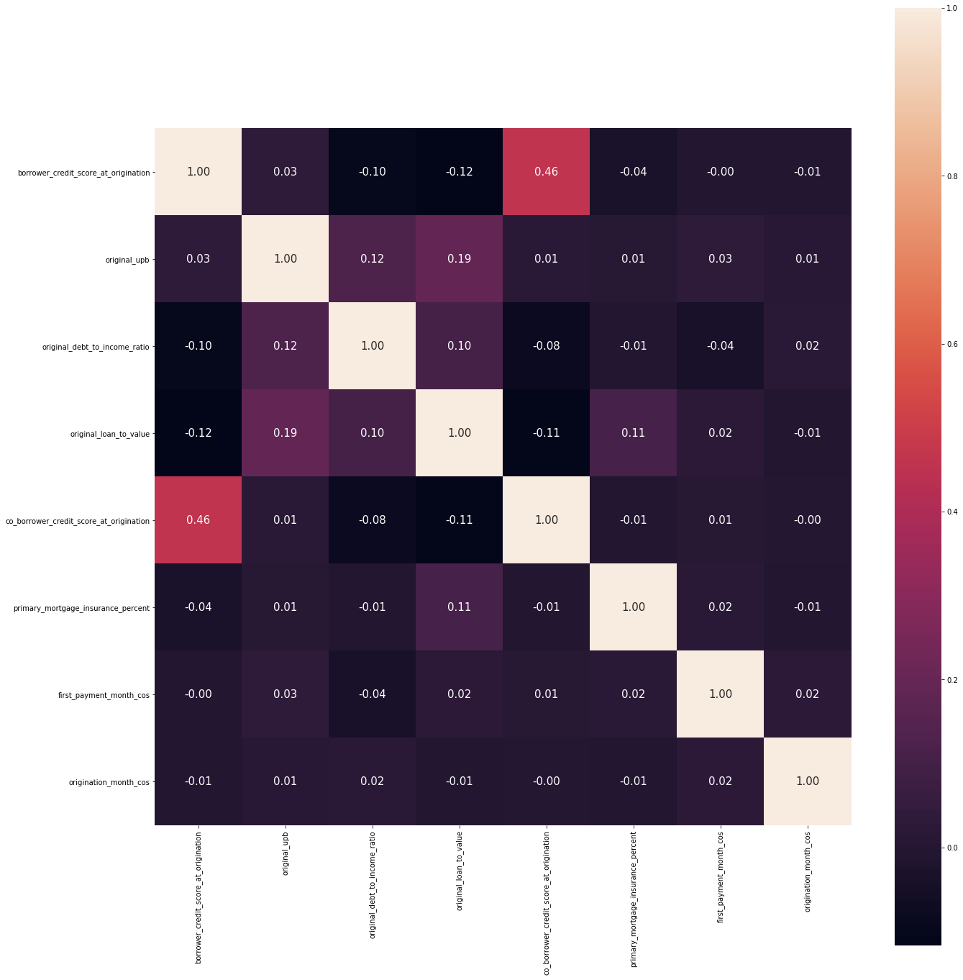
Feature Selection
Takeaways
Feature selection was on a subset
Zip codes sometimes important
Some obvious features
Credit score
Debt to income
What’s interesting about origination month?

Slide 8
Building a Dataset
class LoanPerformanceDataset(object):
def __getitem__(self, index):
# fetch data from SQL
def __len__(self):
# Fetch COUNT from SQL
Purpose
Iterate in chunks
Abstract the loading
Provide helpers to swap states
dataset = LoanPerformanceDataset(
chunk=CHUNK_SIZE,
conn=connect(),
ignore_headers=['loan_id'],
target_column='sdq',
pre_process_pickle_path=’.’
stage='train',
to_tensor=True
)
X, y = dataset[0]

Slide 9
Main

Slide 10
ModelBuilder.py
Class Builder(nn.Module)
GPU/CPU selection
Layer_type
Activation_type
Layers
Activations
Output
Class ModelRunner
Outputs
Losses
Gradients
Performance_index
Optimizer
Dtype
Device
Data_size
Batch_size
Model
Start
Is_image
Dimensions
Pred_output
Collect_grad
Results
Stop_early_at
Adjustment
Drop

Slide 11
Model 1
## ReLu model 2 layer
layers = [
nn.Linear(INPUT_SIZE, NUERONS_l1),
nn.ReLU(),
nn.Linear(NUERONS_l1, CHUNK_SIZE),
nn.ReLU(),
]
2 Layer ReLu Model
92% accurate
Predicted | False | True | All
Actual
False | 55992 | 506 | 56498
True | 3268 | 34 | 3302
All | 59260 | 540 | 59800

Slide 12
Model 2
## Sigmoid model
layers2 = [
nn.Linear(INPUT_SIZE, NUERONS_l1),
nn.ReLU(),
nn.Linear(NUERONS_l1, CHUNK_SIZE),
nn.Sigmoid()
]
Sigmoid Model
97% accurate
Predicted | 0.0 | 1.0 | All
Actual
0.0 | 57872 | 0 | 57872
1.0 | 1928 | 0 | 1928
All | 59800 | 0 | 59800

Slide 13
Model 3
## Relu model 3 layer
layers3 = [
nn.Linear(INPUT_SIZE, NUERONS_l1),
nn.ReLU(),
nn.Linear(NUERONS_l1, NUERONS_l2),
nn.ReLU(),
nn.Linear(NUERONS_l2, CHUNK_SIZE),
nn.ReLU()
]
3 Layer ReLu Model
92% accurate
Predicted | False | True | All
Actual
False | 55794 | 50 | 55844
True | 3956 | 0 | 3956
All | 59750 | 50 | 59800

Slide 14
Model 4
## Softmax model
layers4 = [
nn.Linear(INPUT_SIZE, NUERONS_l1),
nn.ReLU(),
nn.Linear(NUERONS_l1, CHUNK_SIZE),
nn.Softmax(dim=1)
]
Softmax Model
88% accurate
Predicted | 0.0 | 1.0 | All
Actual
0.0 | 56483 | 0 | 56483
1.0 | 3317 | 0 | 3317
All | 59800 | 0 | 59800

Slide 15
Model 5
## dropout model
layers5 = [
nn.Linear(INPUT_SIZE, NUERONS_l1),
nn.ReLU(),
nn.Linear(NUERONS_l1, CHUNK_SIZE),
nn.ReLU(),
]
Droput Model
99% accurate
Predicted | False | True | All
Actual
False | 59511 | 165 | 59676
True | 123 | 1 | 124
All | 59634 | 166 | 59800

Slide 16
Summary/Conclusions
Luke, Vishal, Jason

Slide 17
Future Options
Train with more data
Further dataset tuning
Additional Frameworks
Tuning of hyperparameters

